Slide 1
Building Goodwill
You-Attitude (You View)
Positive Emphasis
Reader Benefits

Slide 2
You Attitude (You Viewpoint)
Looks at things from the READER'S POINT OF VIEW
Shows READER BENEFIT and emphasizes what the reader wants to know
Focuses on the POSITIVE
Protects the reader's ego
Expresses APPRECIATION for your readers
Applies psychology to HUMANIZE our messages
Uses CORRECT ETIQUETTE in all communication media

Slide 3
Ways to demonstrate you attitude
I/we → you
Focus on what the reader receives or can do, not on what you’ve done.
Not YA: (writer centered) | We have spent over six months revising our Audio Visual Services website.
YA: (reader centered) | You will find our streamlined reservation service and up-to-date equipment information on our revised Audio Visual Services website.

Slide 4
Ways to demonstrate you attitude can’t → can
Tell the reader what they CAN do instead of what they CANNOT do.
Not YA: (writer centered) | You can’t use the TV studio to record your presentations without making an appointment.
YA: (reader centered) | Make an appointment at least 48 hours in advance to ensure availability of the TV studio for your presentations.

Slide 5
Ways to demonstrate you attitude be careful with feelings (yours & theirs)
The writer probably isn’t “happy.” The writer shouldn’t tell the reader how to feel.
Not YA: (writer centered) | I am happy to grant you a two-day extension on your project.
Not YA: (reader centered… in a bad way) | You will be happy to know I’m granting you a two-day extension on your project.
YA: (reader centered… In a good way) | You may take an additional two days to submit your project.

Slide 6
Ways to demonstrate you attitude anticipate what the reader wants to know
Think about the what the audience wants. Provide those details.
Not YA: (writer centered) | I graded your project.
Not YA: (reader centered… but doesn’t give details) | Your project has been graded.
YA: (reader centered… In a good way) | You earned a A- on your project. (or) Your project received a D+. (what’s the diff?)

Slide 7
Ways to demonstrate you attitude avoid “you” in negative situations
In negative situations, avoid singling out the reader. Instead, focus on group to which reader belongs.
Not YA: (writer centered) | I must approve all project proposals.
Not YA: (reader centered… in a bad way) | You must get approval for your project proposal.
YA: (focuses on the group instead of individual) | Students’ project proposals must be approved.

Slide 8
Ways to demonstrate you attitude avoid “you” in negative situations
Avoid “you” when it criticizes the reader. Instead, use a passive verb construction or an impersonal construction to avoid assigning blame.
active | You failed to turn in your project.
passive | Your project has not been turned in.
impersonal | Your project is late.

Slide 9
To the Grammatically Challenged
Chill out… this isn’t really grammar.
It’s the rhetorical approach.
It’s about recognizing the variety of choices and picking the best one.

Slide 10
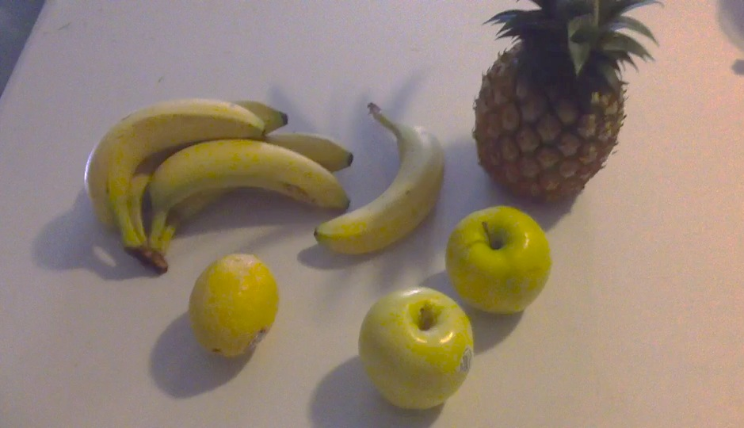
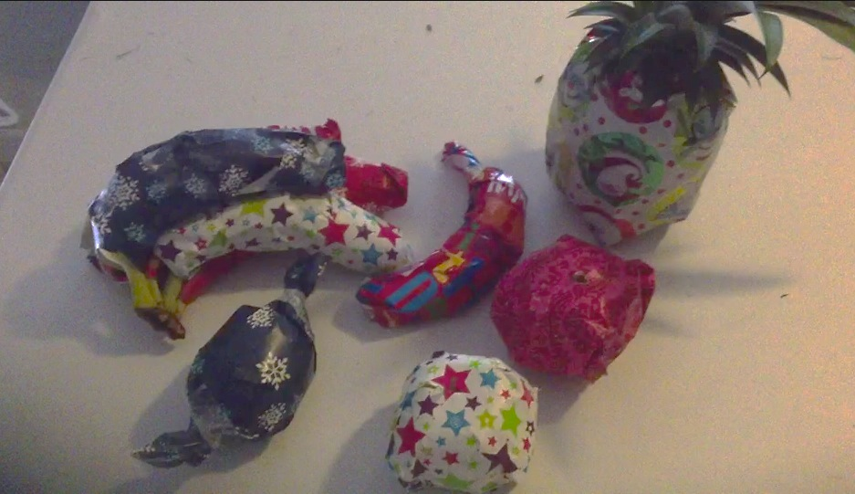
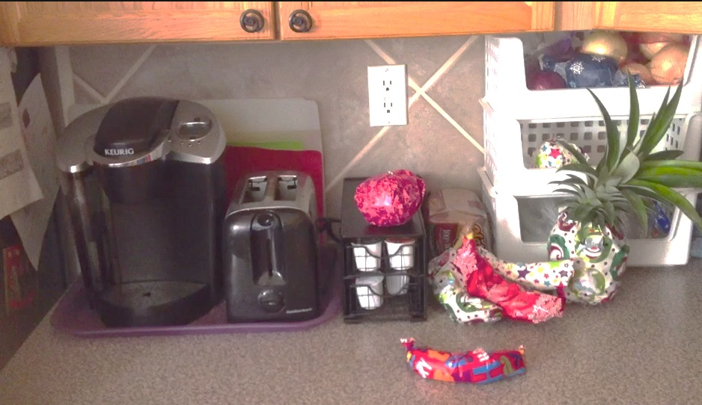
We need to tell Noah his Science Fair Competition project, “The Effects of Pranks on Mom’s Mood,” came in last place.
We could say: “You lost the Science Fair Competition.”
How might we soften the blow?

Slide 11
To the Grammar Nerds….
And to students for whom English is a second, third, or fourth language (students who often know grammar much better than native speakers)
Chill out… this isn’t really grammar.
We aren’t using “the rules.”
We’re using a rhetorical approach.

Slide 12
Ways to demonstrate you attitude avoid “you” in negative situations
Situation: Something negative.
Goal: Deemphasize readers responsibility. Avoid blaming the reader.
active | You failed to turn in your project.
passive | Your project has not been turned in.
impersonal | Your project is late.

Slide 13
Active Construction
The subject performs the action in the verb.
(since we’re writing to/about people, we could say…)
The person does/did something.
You did not fill out the job application completely.

Slide 14
Passive Construction to deemphasize responsibility
Passive Verb/Construction: the person (subject) is implied, but not in the sentence.
Active: You did not fill out the job application completely.
Passive: The application was not filled out completely.

Slide 15
Impersonal Construction to deemphasize responsibility
Impersonal Construction: The thing/object performs the action.
Active: You did not fill out the job application completely.
Impersonal: The application is incomplete.

Slide 16
How to tell the difference
Active: You did not fill out the job application completely.
Passive: The application was not filled out completely. (by who? who didn’t fill out the application?)
Impersonal: The application is incomplete.
(bad, bad application!)

Slide 17
How to tell the difference
Active: Cindy failed to turn in her project on time.
Passive: The project was not turned in on time. (by who? who didn’t turn in the project on time?)
Impersonal: The project is late. (bad, bad project!)

Slide 18
Creating Positive Emphasis
Focus on what the reader can do rather than on limitations. ✓
Eliminate negative words and words with negative connotations.
Justify negative information by giving a reason or a reader benefit.
4. If the negative is truly unimportant, omit it.

Slide 19
Create positive emphasis:
Eliminate Negative Words
& Words with Negative Connotations
afraid
anxious
delay
delinquent
dissatisfied
error
fail
failure
loss
misfortune
missing
not
problem
regret
reject
weakness
Notes:
14

Slide 20
Create positive emphasis:
Eliminate Negative Words
& Words with Negative Connotations
I’m afraid you were assigned a broken chair.
One weakness in your project is your budget.
You are unable to file for an exemption until the fall.
Noah failed to turn in his library books on time.

Slide 21
Include Reader Benefits
(always, and particularly in “negative” situations)
Benefits and advantages the reader gets from
  using your services
  buying your products
  following your policies
  adopting your ideas
  doing a thing they might not want to do
Good reader benefits are
  adapted to the audience, demonstrates value to reader (includes what reader values most, e.g., saving money vs. saving time)
  phrased in reader-centered language (You-View/You-Attitude)
  often “frontloaded”

Slide 22
Include Reader Benefits
(always, and particularly in “negative” situations)
We need your contact information.
Fill out this card with your contact information.
Fill out this card with your contact information so you can continue to receive updates about coursework.
Fill out this card with your contact information so you can continue to receive updates about how to earn an A in your classes.
To ensure you continue to receive updates about earning As in your classes, please fill out this card with your contact information.

