Slide 2
Finding a job
Monster, Hotjobs, etc. ??
Google it!!!
Talk to someone in your field – an employee, professor, etc.
Search company websites for listings
Look at Professional Organizations and Association websites

Slide 3
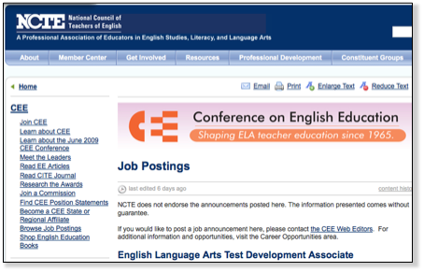
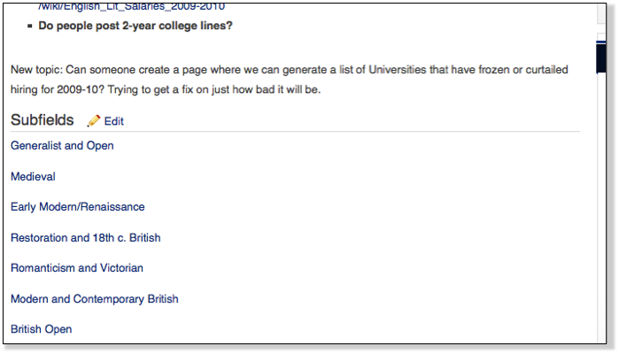
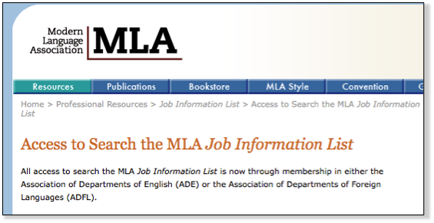
NCTE
MLA
Academic
Jobs Wiki

Slide 4
Accounting?
NSA - National Society of Accountants
  http://www.nsacct.org/
AICPA - American Institute of CPAs
  http://www.aicpa.org/Pages/default.aspx
NSAC - National Society of Accountants for Cooperatives
  http://www.nsacoop.org/

Slide 5
Due Friday: Job Listing
(to use for Job Search Portfolio)
a desirable, real job in your field that you could likely obtain directly after graduation.
you must qualify (or near qualify) after obtaining your degree
must be in your preferred geographic area
no temp agencies, telemarketing
must include company name (no “will reveal” or “a company”)

Slide 6
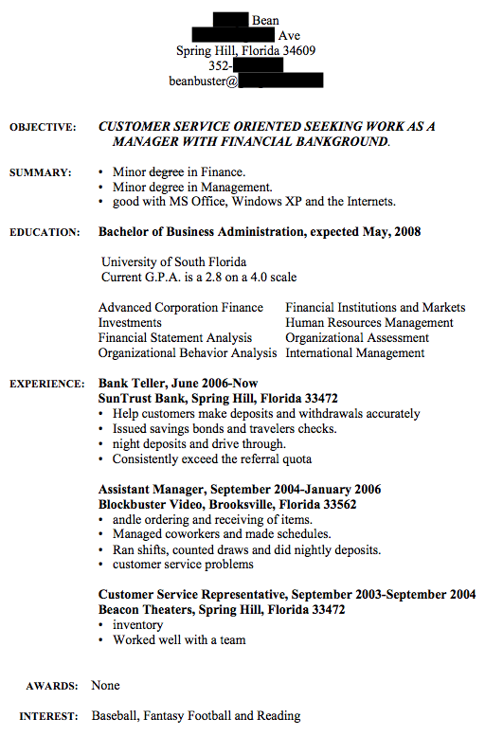

Slide 7
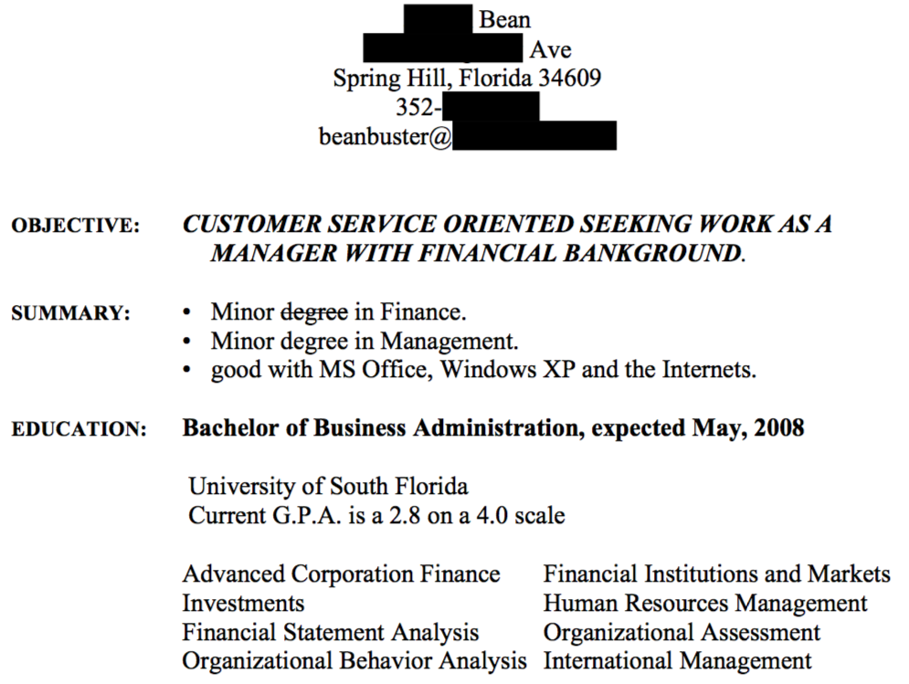

Slide 8
